Slide 1

EXERCISING OR DIETING? WHICH METHOD IS MORE EFFECTIVE?
PRESENTED BY:
AHMED ROHAIL
MUHAMMAD ALI
TALHA DOGAR

Slide 2

OVERVIEW
THIS PRESENTATION WILL BE ABOUT A COMPARIOSON AND CONTRAST ESSAY ON THE TOPIC “EXERCISING OR DIETING? WHICH METHOD IS MORE EFFECTIVE?
INTRODUCTORY PARAGRAPH WILL CONTAIN THE STANCE AND THE THESIS STATEMENT.
THERE WILL BE THREE BODY PARAGRAPHS THAT WILL COVER THE SIMILARITIES AND DIFFERENCES BETWEEN BOTH THE METHODS.
AT THE END THERE WILL BE A CONCLUDING PARAGRAPH WITH A RESTATEMENT OF THE THESIS AND SIGNIFICANCE OF THE TOPIC.

Slide 3

INTRODUCTION
70% OF RESEARCHERS CONCLUDED THAT DIETING IS MORE EFFICIENT .
DIETING IS MORE EFFECTIVE THAN EXERCISING.
ADVANTAGES OF A BALANCED DIET OUTWEIGH THOSE OF EXERCISE.
CALORIES MANAGED EFFICIENTLY.
BETTER NUTRITION.
PREVENTS CHRONIC DISEASES.

Slide 4
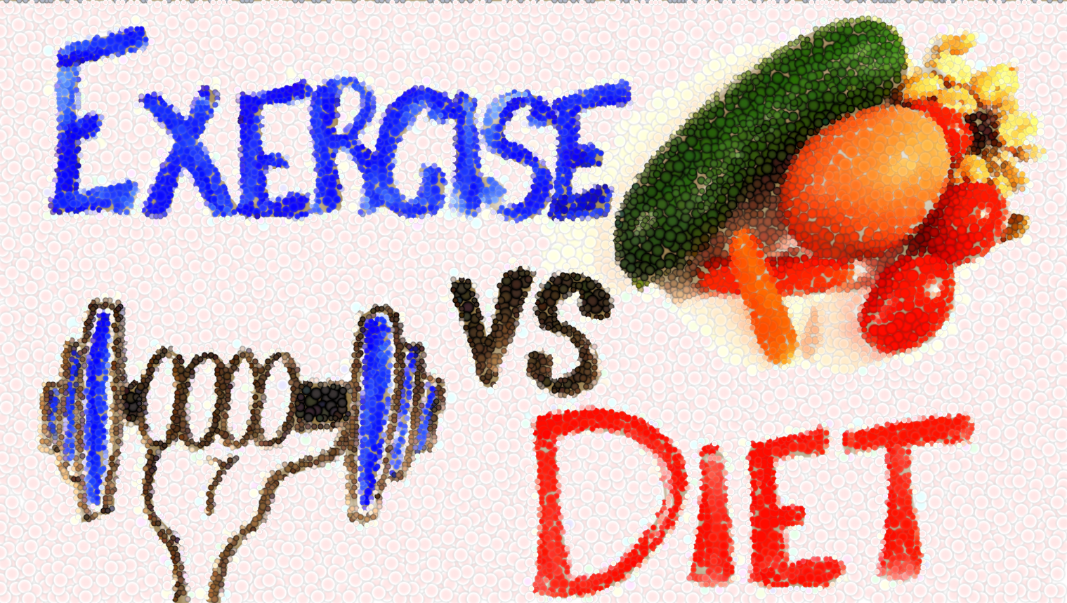
FIRST BODY PARAGRAPH
SIMILARITIES
BOTH HELP IN MANAGING THE CALORIES EFFICIENTLY.
DIFFERENCES
EASIER TO LOSE CALORIES WITH A BALANCED DIET.
DIFFICULT AND MORE TIME CONSUMING TO BURN CALORIES WITH EXERCISE.

Slide 5

SECOND BODY PARAGRAPH
SIMILARITIES
BOTH ARE NUTRITIOUS FOR THE BODY
DIFFERENCES
HEALTHY DIET FULFILLS NUTRIENTS OF THE BODY
EATING UNHEALTHY FOOD AND EXERCISING LATER ON CAN BE HARMFUL FOR THE BODY

Slide 6

THIRD BODY PARAGRAPH
SIMILARITIES
PREVENTS CHRONIC DISEASES
DIFFERENCES
EXERCISING TOO HARD CAN LEAD TO DISEASES

Slide 7

CONCLUSION
DIETING IS BETTER THAN EXERCISING
CUTTING CALORIES
MORE NUTRITIOUS
PROTECTS FROM LONG-TERM DISEASES
EXERCISE HAS ITS ADVANTAGED BUT BENEFIT OF A BALANCED DIET OUTWEIGH THEM

